Slide 1


Cross-boundary Implementation of Climate Adaptation Plans in Denmark - a LIFE Integrated Project
Indian Clean Energy & Climate Partnership Tour
Copenhagen, 13 April 2018
Rikke Nan Valdemarsen, Academic Officer

Slide 2
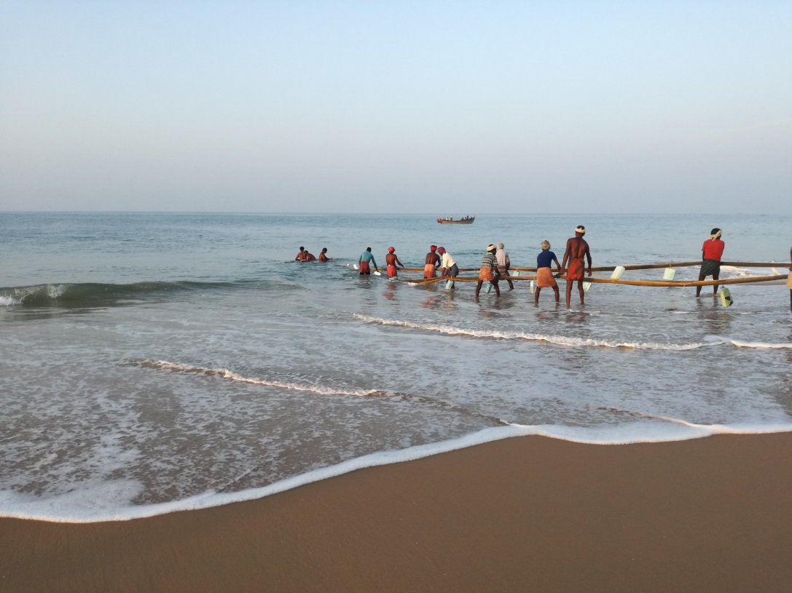
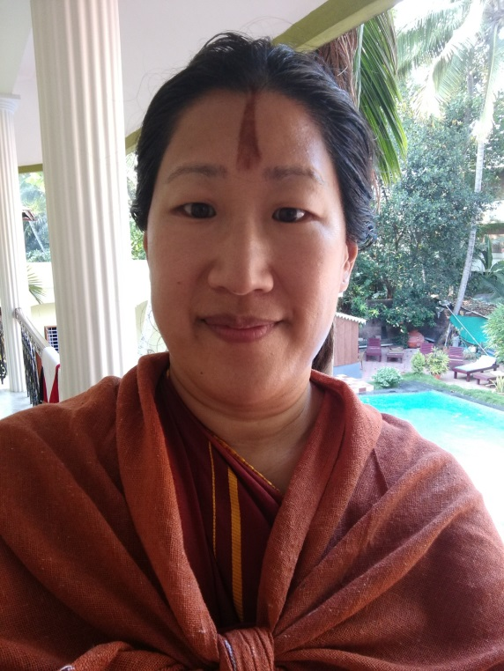
Who am I?

Slide 3
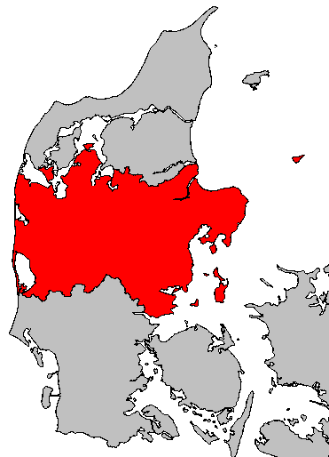
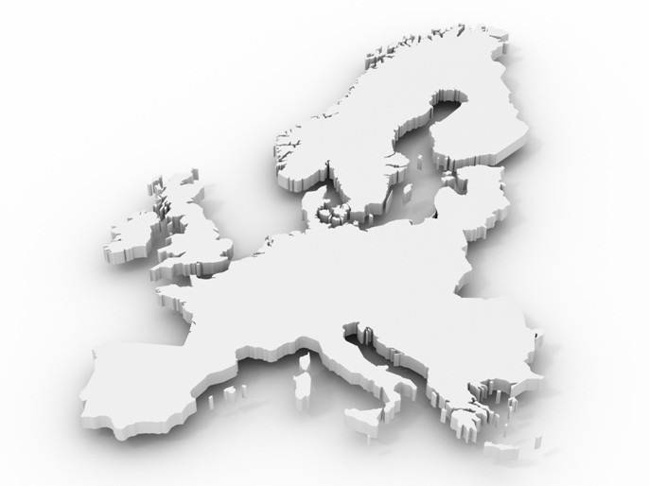
Introduction to
Central Denmark Region
Denmark
5.5 mill. inhabitants
5 regions
98 municipalities
In Central Denmark Region:
Highest point 178 m
2,500 km of coast
10,000 km of streams

Slide 4
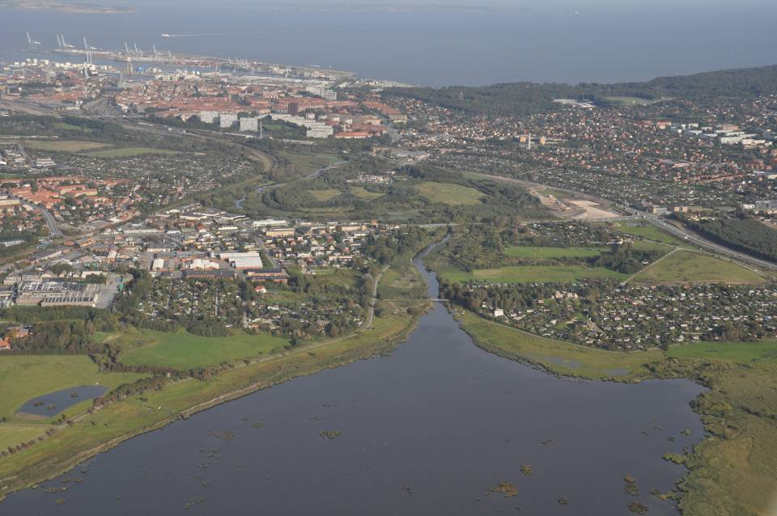
Water challenges in the year 2100 (in Denmark)
10 - 40% increased precipitation
½ - 1 m higher sea level
5 - 15 % increased run-off water
Mutually recognised challenges
0 - 2 m higher groundwater table

Slide 5
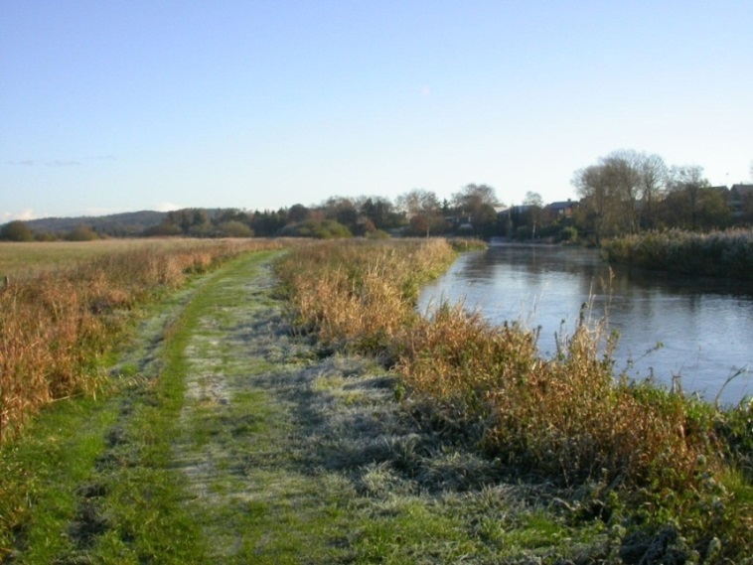
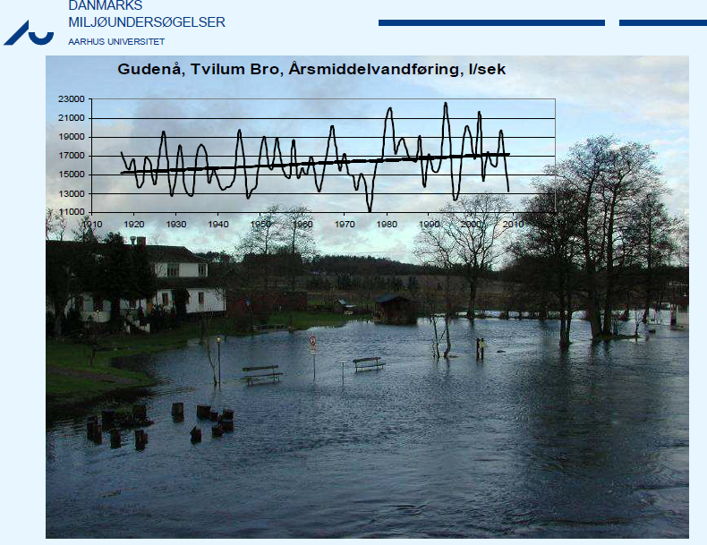
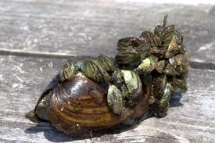
River challenges in the Gudenå
Mean annual flow, litres per second
Notes:
Invasive species of clams

Slide 6
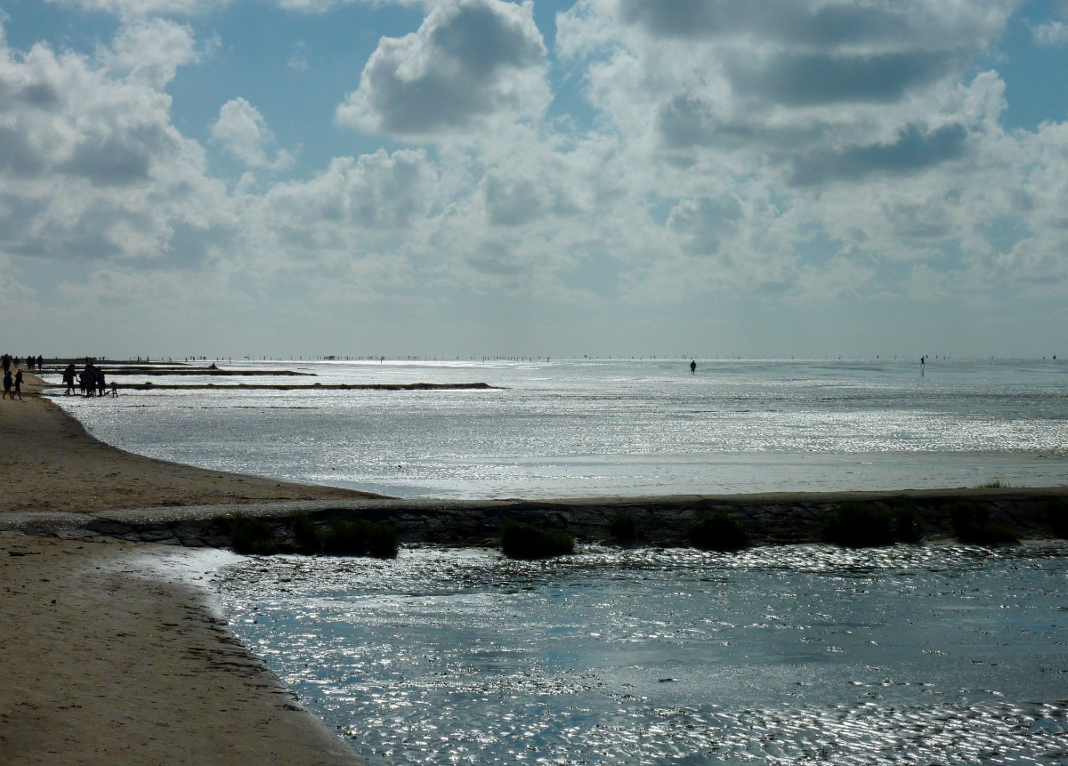
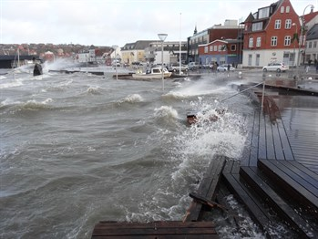
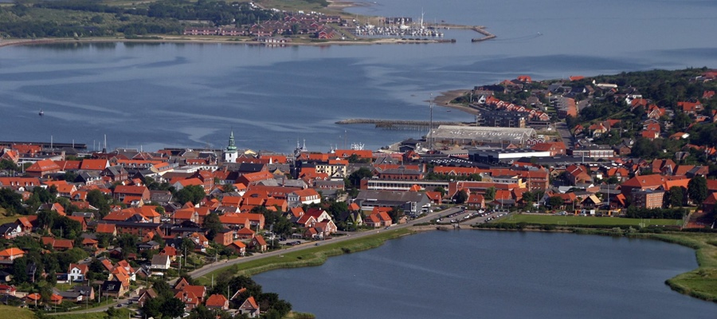
Coastal Challenges

Slide 7
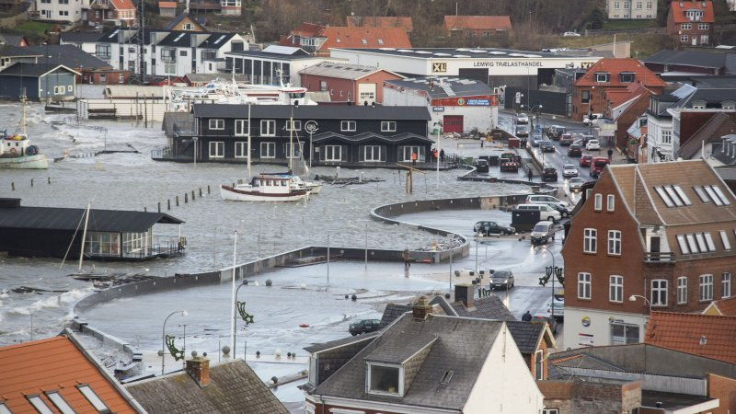
Water knows No Frontiers

Slide 8
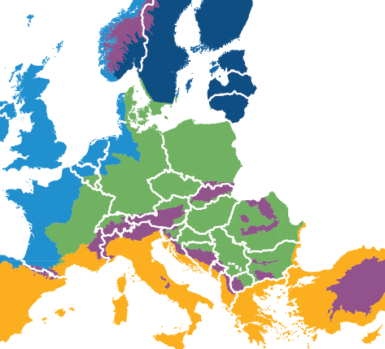
Following CH, DK has the highest European losses connected to water incidents!
Climate change affect us in various ways, e.g. extreme heat in Southern Europe and more water in the North.
Our challenges are similar to many other places in the world.
No matter how much we limit the CO₂ emissions, the climate changes and we need to adapt!

Slide 9
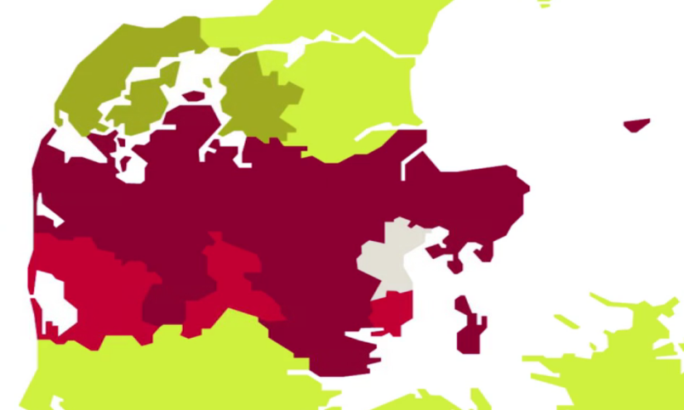
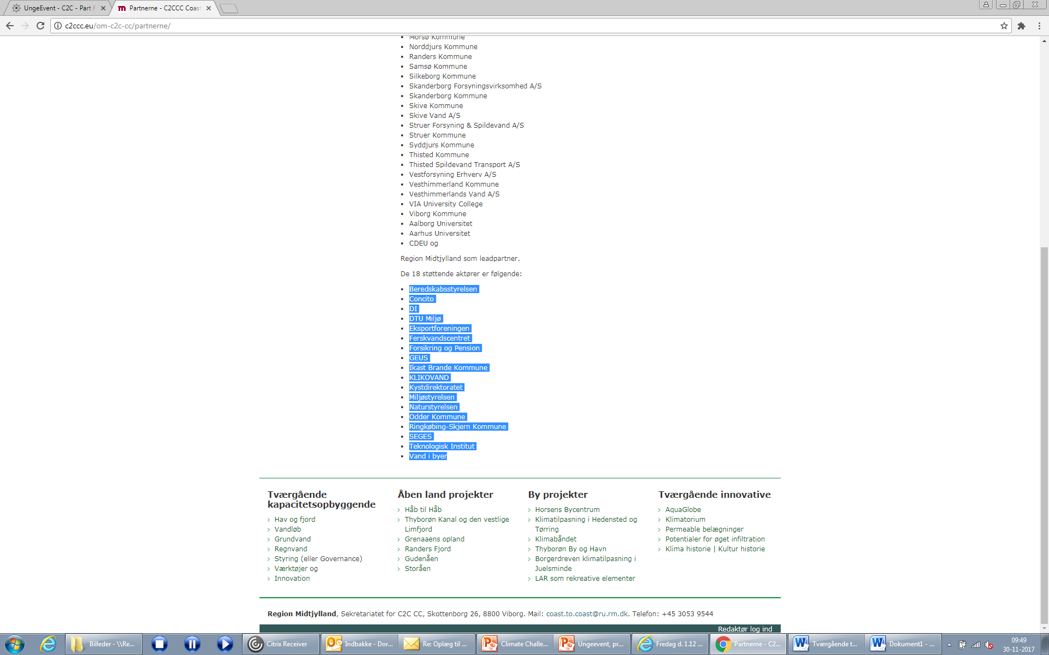
The Project
Partners of Collaboration
Supporting Partners
Project period 6 years
Budget EUR 12m
Support EUR 7m

Slide 10
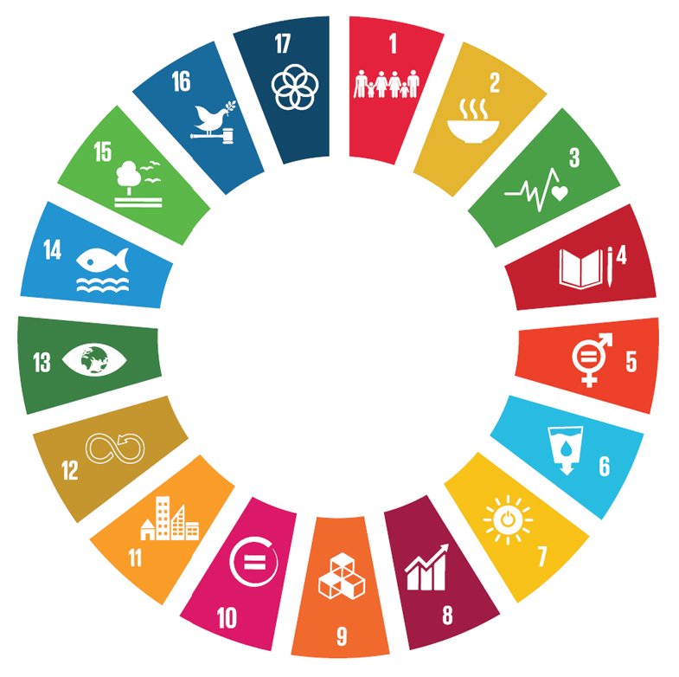
The Direction
Capacity building and sustainable

Slide 11

1 region
18 municipalities
8 water companies
3 universities
1 EU rep. office
= 31 partners
+ 17 co-partners
Life project: 6 years
12m EUR
SEA & FJORDS
RIVERS
GROUNDWATER
C2C CC Matrix
RAINWATER
GOVERNANCE
24 Actions
TOOLS
INNOVATION
SUSTAINABILITY
CAPACITY BUILDING

Slide 12
Governance
Hands on Preparatory Actions A1
Mobilising broad partnerships (Bulgaria)
Challenges, the partners needed to solve anyway, and which they could not solve on their own
Synergies and opportunities in co-creation
Improving processes during co-creation
Gaps finding in existing legislation
Legislation, new paradigm for maintenance
The UK, the watertrusts (no demands from the governance side), local stakeholders and local ownership result in succes and maintenance

Slide 13

The overall objective
Better mutual planning than one can do alone
Efficiently taking care of water related climate challenges and turning them into business opportunities and improvements of society
Joint vision and strategy, collaborative planning and division of labour
Creating a Danish information centre, paving the way in Europe

Slide 14

We have the platform!
Thus we have good prerequisites for
developing, testing, manufacturing and selling new solutions
We must
develop and demonstrate new solutions and concepts
train the labour force
create the necessary organisations (networks, cross-boundary collaborations, information centres etc.)
In other words, we shall collaborate on
a shared vision
a joint strategy
coordinating plans
a rational division of labour

Slide 15
Le Mur in Lemvig is a multifunctional solution

Slide 16
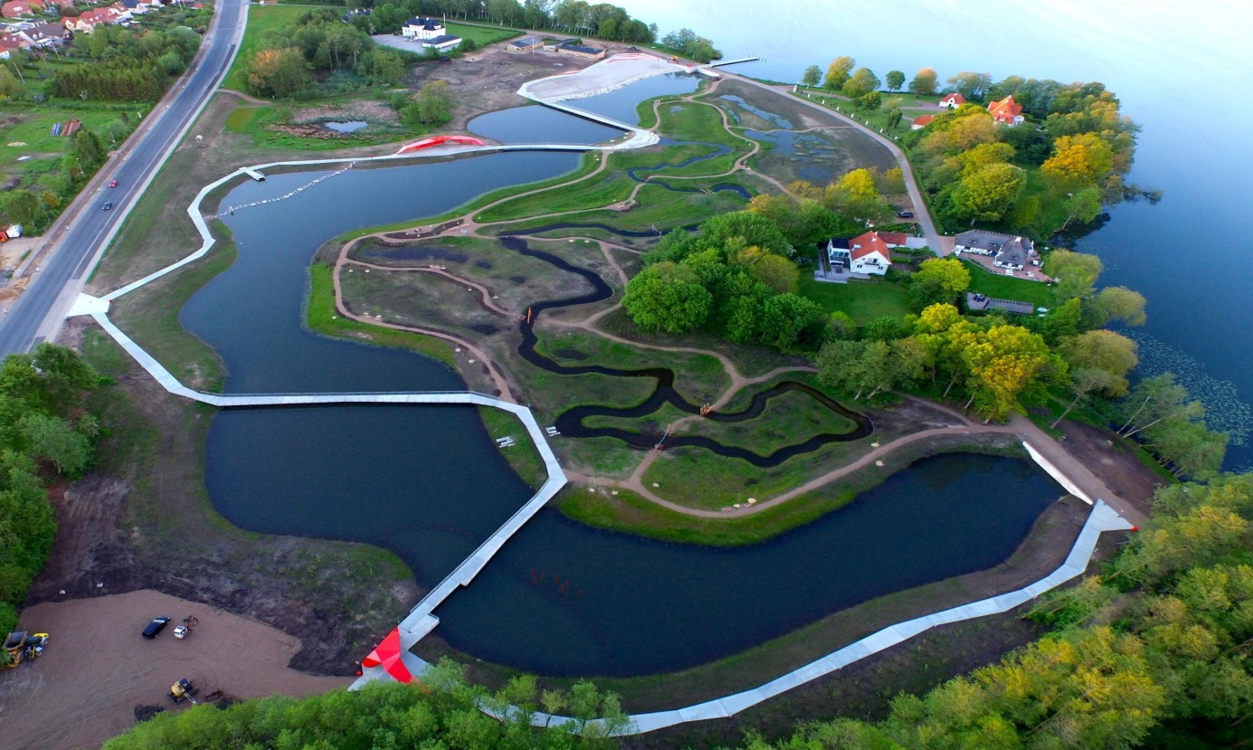
sØnæs in Viborg is a multifunctional solution

Slide 17
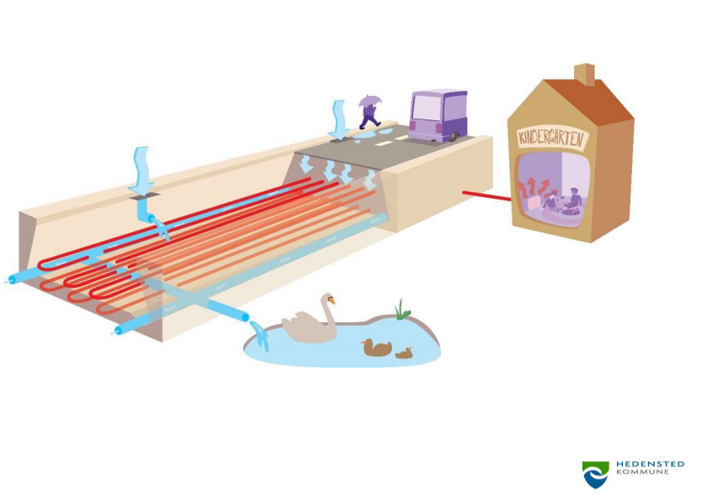
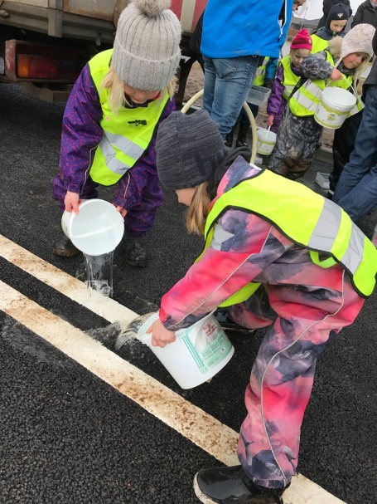
Klimavejen in Hedensted
Notes:
VIA University College and Hedensted Municipality. Ph.D students. Innovation. Lemvig Public Utility. Exports. 13 participants. ECCA Glasgow (European Climate Change Adaptation Conference). NCC (construction), Lemvig Public Utility and Klimatorium did initial sale to NZ. With VIA University College and Lemvig Public Utility did collaboration with interest for NZ. Prolongs training of engineers. Study tour to NZ.

Slide 18
Klimavejen – permeable asphalt with a multi functional solution
Precipitation is used for district heating of a kindergarten
Innovative collaboration started among participants, on a European Climate Change Adaption Confence in Glasgow, where they met by chance
13 participants, VIA University College, PhD students, Hedensted Municipality, and Lemvig Public Utility.
NCC (construction), Lemvig Public Utility and Klimatorium did the initial sale to NZ.
VIA University College and Lemvig Public Utility collaborated with an interest in NZ.
Resulting in prolonged training of engineers, and a study tour to NZ.

Slide 19
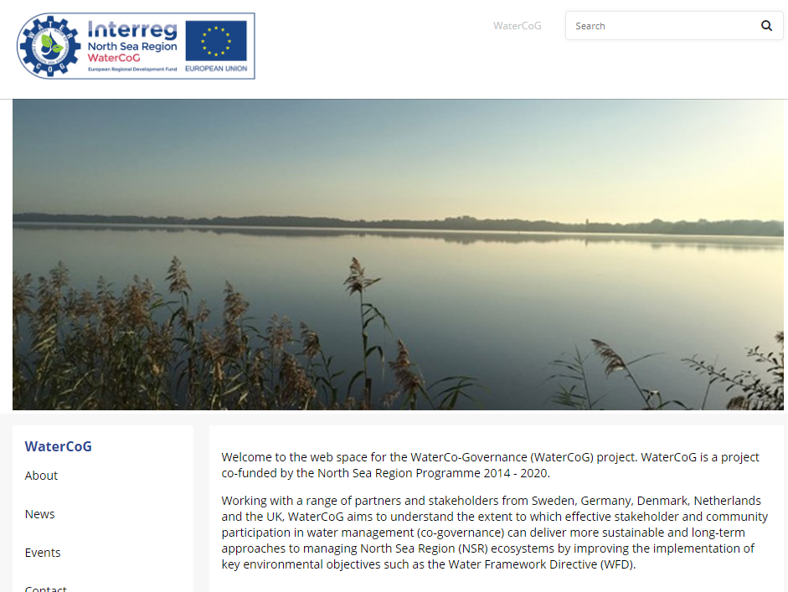
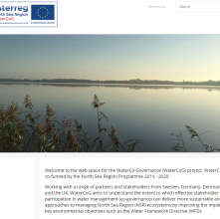
WaterCoG
Notes:
Out of C2C CC scope. Complementary.

Slide 20
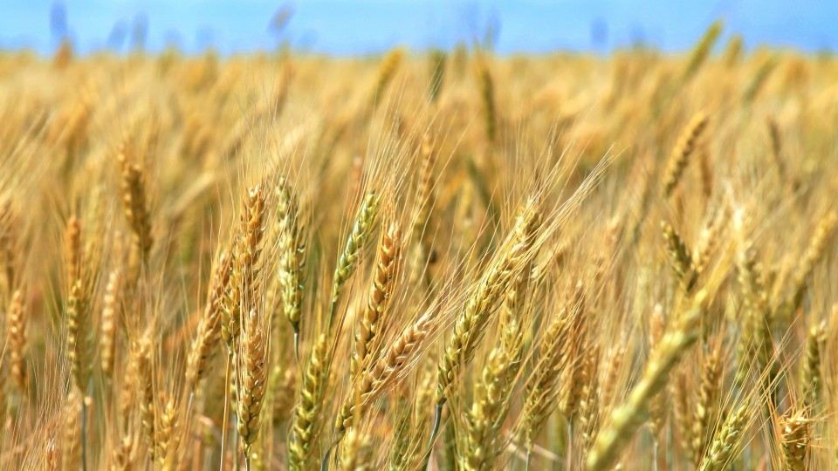
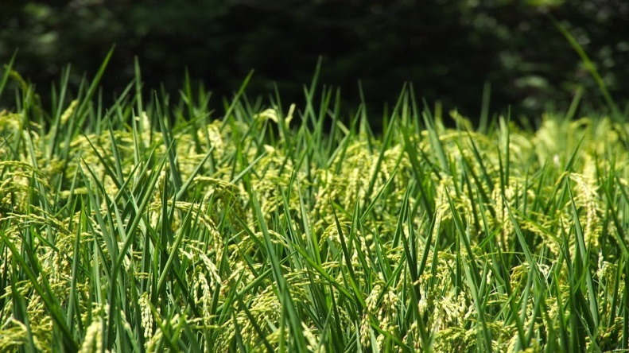
Many changes are needed
Rice in future?
Adaption of sustainable agriculture
Now wheat

Slide 21
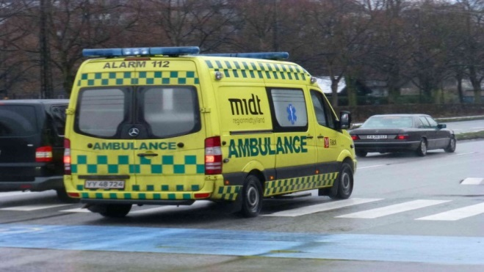
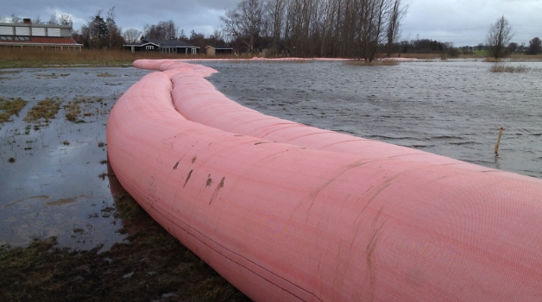
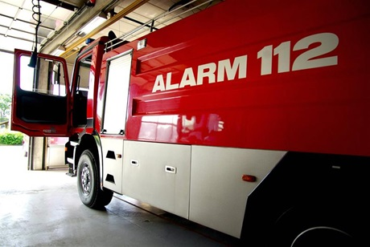
We need to be prepared for flooding

Slide 22
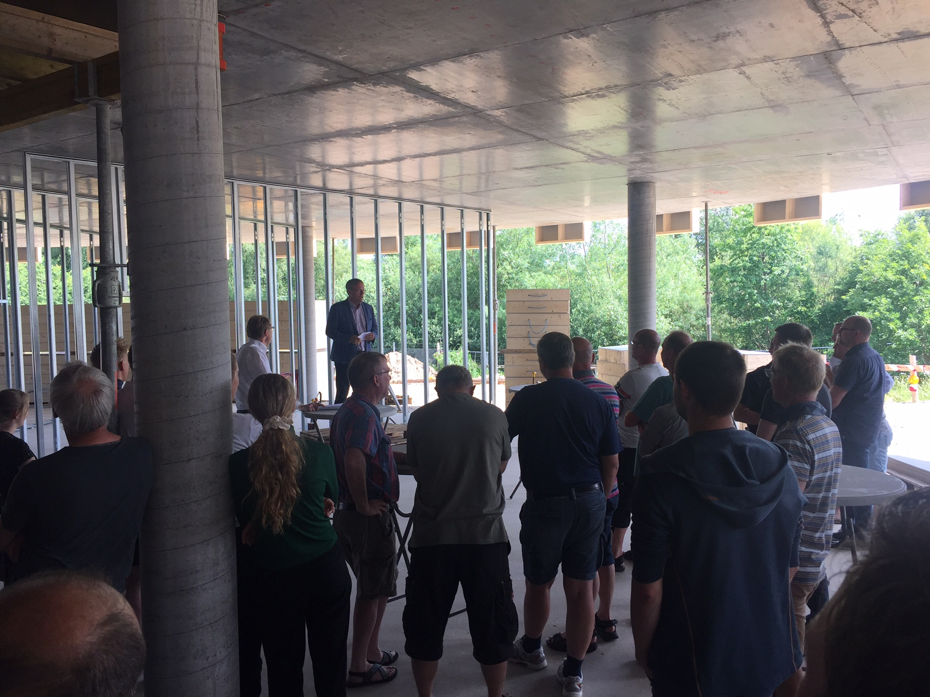
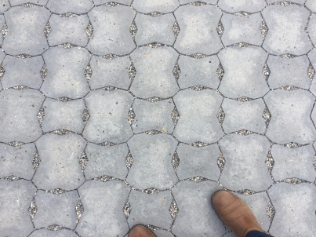
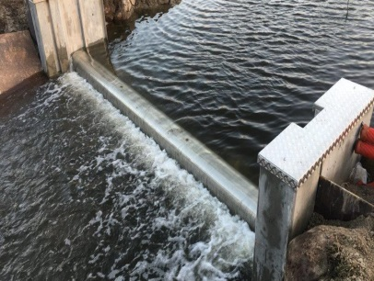
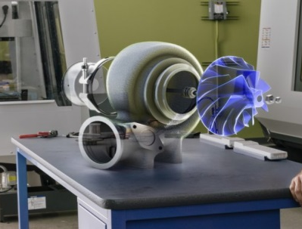
Business Opportunities
Permeable
pavements
Adaptive
sluices
Efficient
pumps
C4

Slide 23
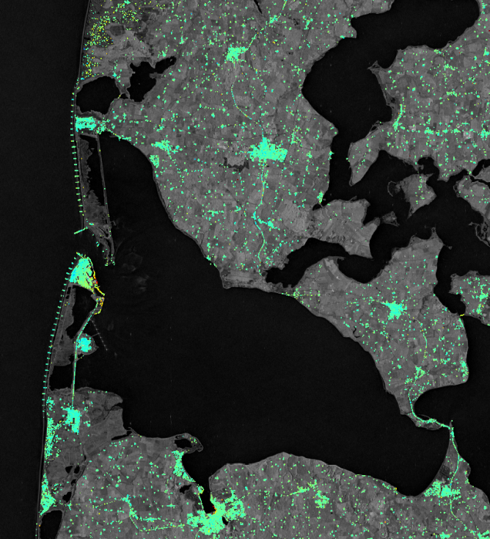
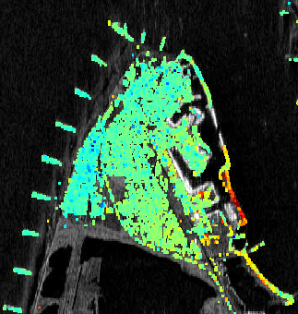
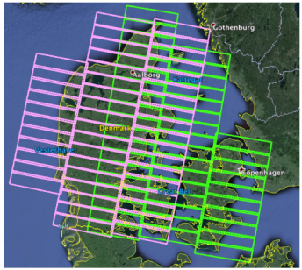
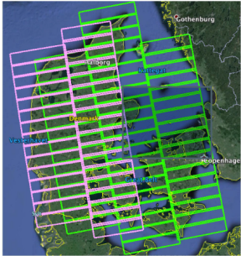
Remote Sensing as a Tool – using the Copernicus programme data
Copernicus programme,
Sentinel-1: High spatio-temporal resolution and spatial coverage
Data acquisition ensured until 2030
Free and open data policy
Great potential for nationwide deformation monitoring!
Sentinel-1
(2014 – 2016)
Ref: PPO.Labs, NORUT, NGU (2017)
Source:
Agency for Data Supply and Efficiency, Danish Ministry of Energy, Utilities and Climate

Slide 24
Game changers – new paradigms in innovation and business development
Eco System Services
Nature based solution
Biodiversity

Slide 25
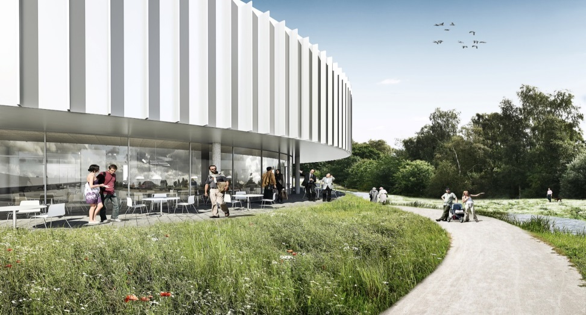
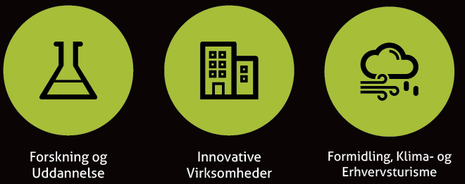
To udstillingsvinduer
AquaGlobe
Klimatorium
Notes:
Research and education. Innovative companies. Dissemination, climate and business tourism.

Slide 26

Dissemination
Climate history / cultural history
Communication to raise awareness among citizens
Platforms like museums, and 2 beacons, Klimatorium and AquaGlobe
Films
Events
AquaGlobe

Slide 27
C2C CC – a Pathway to a Climate Resilient Region
AIM
Becoming a climate resilient (SDG) region is reached fast and efficient
Smart knowledge based Climate Change Adaptation is implemented locally and regionally
Technical and stewardship guidance and support across and from outside the consortium to implement local and catchment based CCA solutions
PROCESS
Capacity development for the use of climate adaption, targeted decision makers
Science-based climate change adaptation knowledge
(methods, data and innovation)
Notes:
SDG: (United Nations) Sustainable Development Goals
Stewardship: ledelse/forvaltning
CCA: Climate Change Adaptation

Slide 28

The Life Integrated Project Coast to Coast Climate Challenge is,
48 triple/quadruple helix partners making the region climate resilient
focusing on catchment based holistic solutions
working on climate adaptation and water in partnerships
combining societal challenges with business opportunities
a truly integrated project

Slide 29
Thank you for listening
Rikke Nan Valdemarsen rikke.nan@ru.rm.dk
Mobile +45 29 64 60 52 www.c2ccc.eu

