Slide 1
Overview of the climate adaptation challenges and actions in the region
ECCA Session Wed 7th of June2017
?
?
Rolf Johnsen, Chief consultant

Slide 2
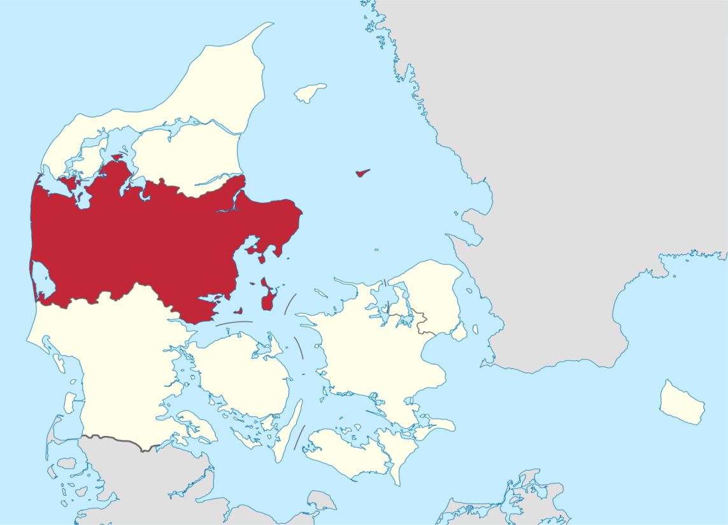
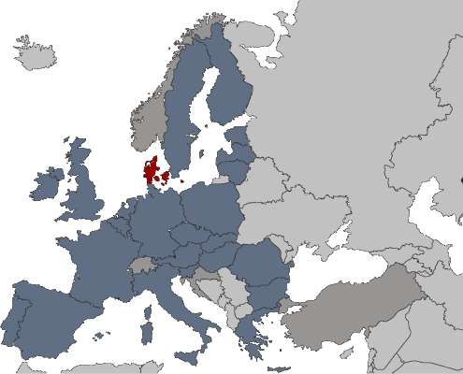
Central Denmark Geography
Central Denmark Region Geography:
Area: 13.053 km²
Coast line app: 2500 km
Protected water coarses: 7.786 km

Slide 3
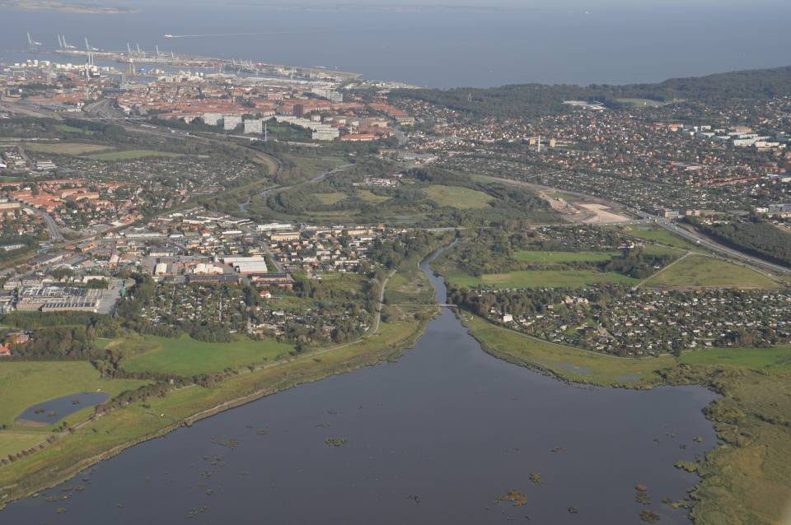
Challenges with water DK year 2100
10-40% precipitation
Common perceived challenge
½-1m sea level changes
5-15 %
Increased
Run off
0-2 m Ground water level
3 ▪ www.regionmidtjylland.dk
Notes:
Udover kommer der mere energi i systemet og skybrud og storme bliver hyppigere
3

Slide 4
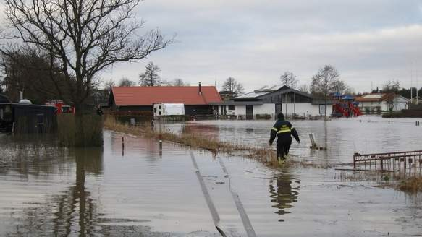
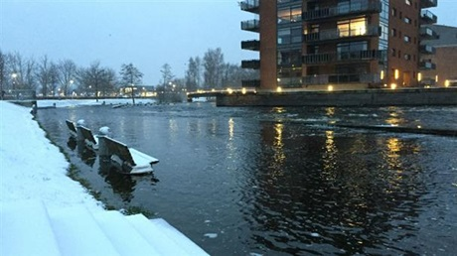
Values at stake
Common perceived challenge
Midtjylland 2015
4 ▪ www.regionmidtjylland.dk

Slide 5
CCA – Movement in Denmark
Threat
Possibility
Possibility+
Driven by sustainability
National/international
Networks
Driven by water in balance
Regional approach
Organisation across columns
Driven by fear
Local knowledge
Organisation in columns
Notes:
From fear to benefit
From coloumns to network
From isolated to mobilising
knowledge+proces+direction

Slide 6
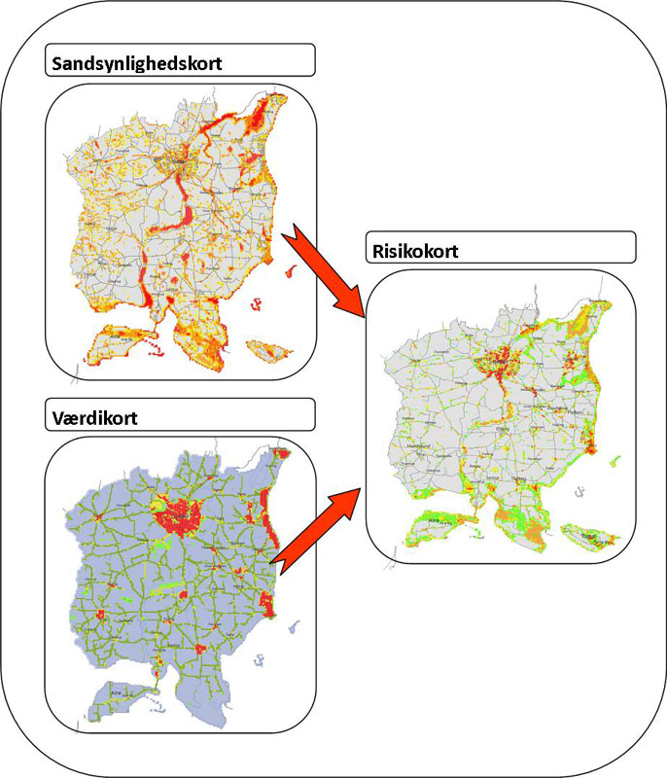
CCA Plans
Probability map
Implementation of local climate adaptation plans
Increase resilience in society
Prepared on the basis of risk mapping
Risk Map
Value Map

Slide 7
C2C matrix
SEA & FJORDS
RIVERS
GROUNDWATER
RAINWATER
GOVERNANCE
24 Actions
TOOLS
INNOVATION
SUSTAINABILITY
CAPACITY BUILDING

Slide 8
Thank you for your attention
For additional info:
www.c2ccc.eu

Slide 9
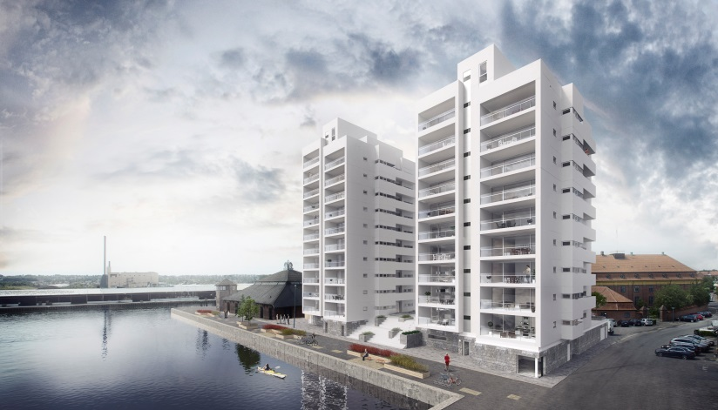
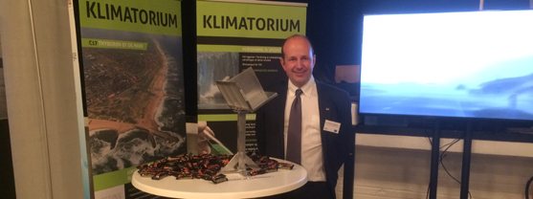
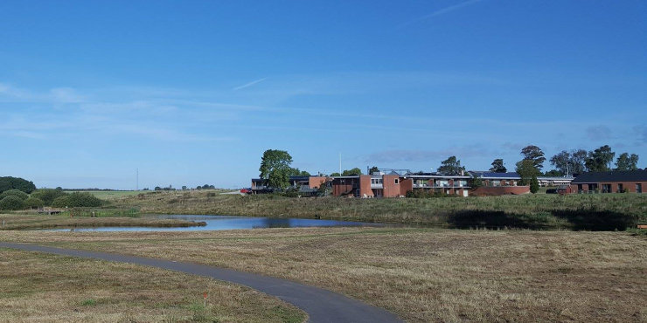
C2C Examples
Le Mur, Lemvig
Horsens town
Brobuerne, Struer
Climatorium
Grenaa river catchment

