Slide 1
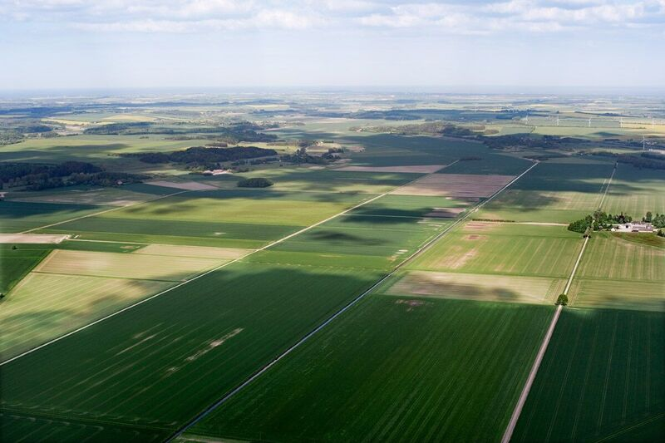
Catchment of the River Grenaa
ECCA Glasgow, 7/6-17
Steen Ravn Christensen
Sidsel Kontni Prahm
Notes:
Now we move from the city to the rural area
In the rural area we have open land, space for water, but nothing is as simple as that.
We have agriculture and organizations strongly opininated towards new use of the land

Slide 2
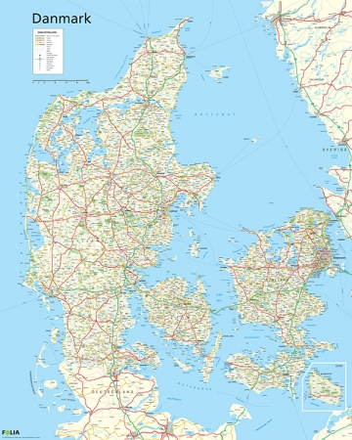
The catchment of the River Grenaa
Notes:
The area in qustion
A catchment area of 500 km2 in connection to seweral cities
Cross municilities
In this project we try to place the future direction of development in the area. We try to set af direction on future dicisionmaking cross municipalities
The area is apointed as problematic in adaption plans

Slide 3
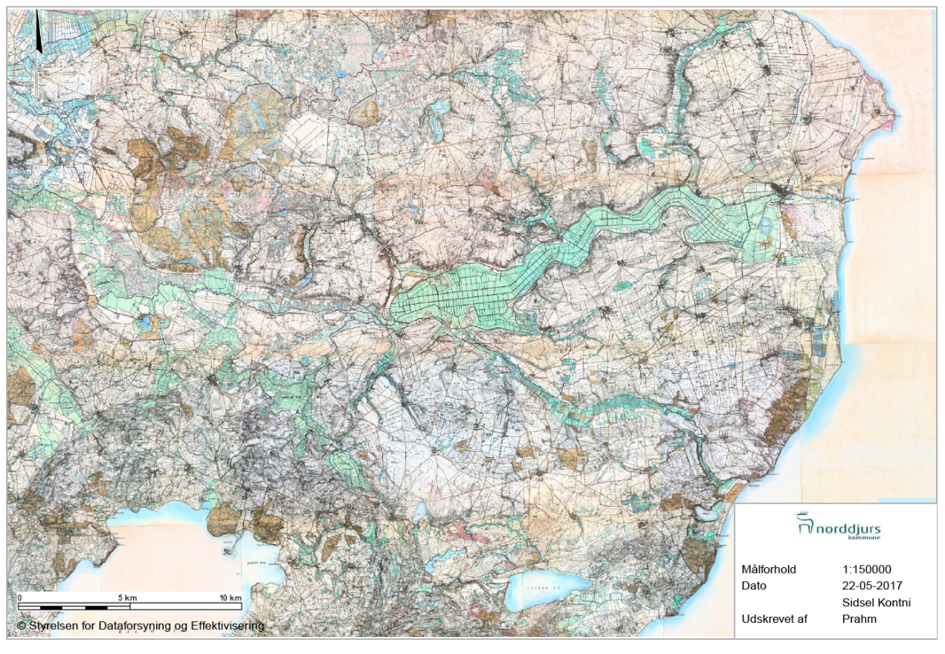
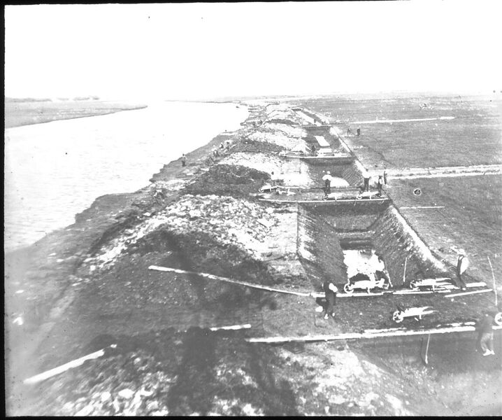
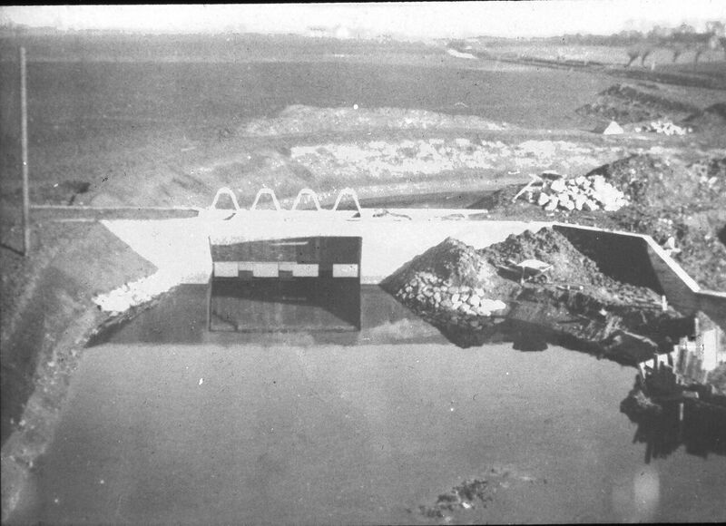
The history of the catchment area
Notes:
Contains much family history
2. lagest lake in DK with open connection to the sea Kattegat
Huge projact for reclaiming the area in the end of 1800 for agriculutral purpose
9 families are satuated in family farms in the area
This project for investigating the area and its connection towards future planning – it has been tried for 20 years, now we have a project

Slide 4
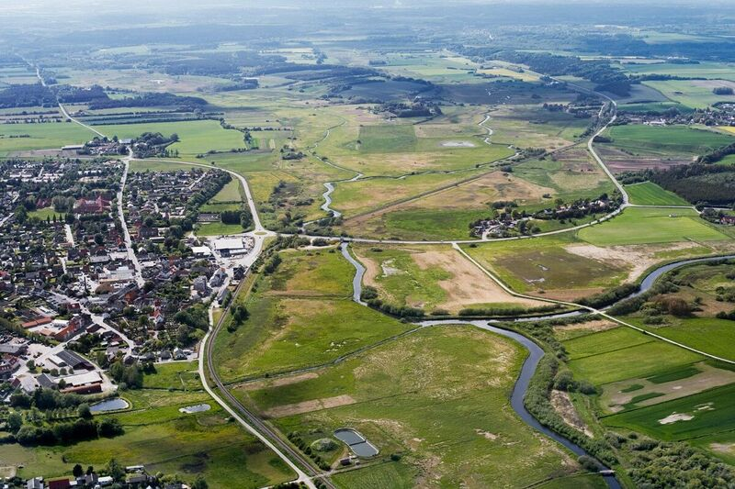
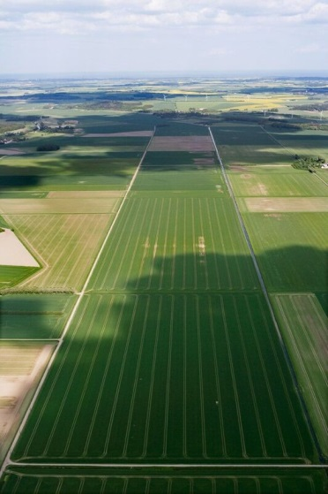
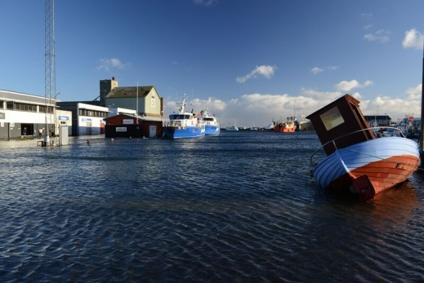
C2C CC is important
Awareness beyond a single municipality
Part of a cross border climate adaption project
Notes:
Window of opputunity
Gave awaness and fokus for shared challenges cross administration borders
Opetunity for coordinated participance in both councils

Slide 5
Outcomes of the project
Phase 1. 2017-2018
Technical report of the complex data
Workshop for NGO’s to ensure broad awareness
Phase 2. 2019-2020
Complex hydrological model of the area
Scenaries of future climate adaption in the area
Phase 3. 2020-2022
Report of final solutions for climate adaption and the socioeconomic analysis
Notes:
Challanges with seawater, rivers, rain, drainage, raising groundwater, - therefore hydrological modelling nessesary
Interessets and many of them
Much involvement, controlled management, and fredom of speach
Tool for decisionmaking, and broad angered development ind the area

Slide 6
Active dialogue as a driving force
Phase 1, Collection of data
Phase 2, Hydrological model
Phase 3, Socioeconomic analysis
Anchored management group
Anchored group of NGO’s and landowners
Open digital portal
Open workshops
Notes:
Dialog and involvement as driver
Fokus on possibilities instead of limitations
Political involvement and ownership
Work with digital solutions fo ropen dialoc
Their project and future plan for the area

