Slide 1
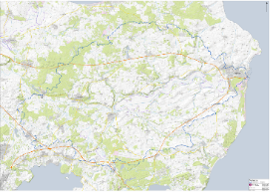
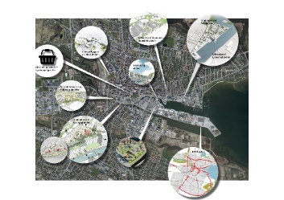



Questions
How do we balance between strong stakeholder interests?
What are your best advice on how to avoid habitual thinking and ‘think out of the box’?

Slide 2

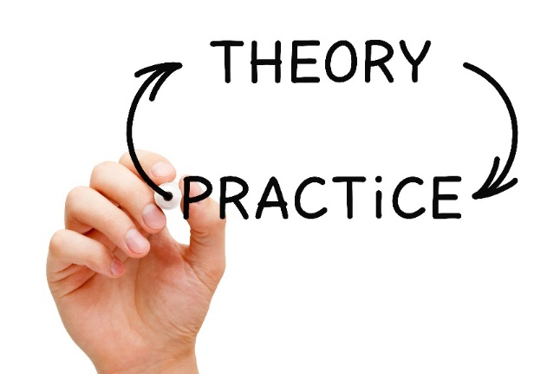
Cross boundary capacity building
ECCA Session Wed 7th of June2017
Anja Skjoldborg Hansen Chief consultant

Slide 3
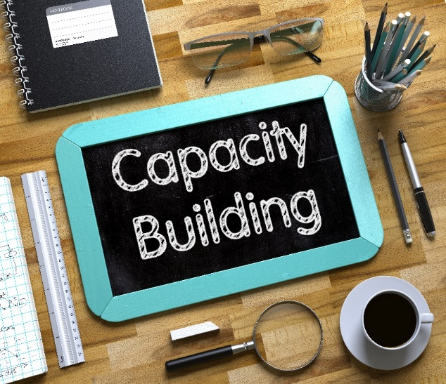
Why capacity building?
Strengthening resilience is a main objective within C2C CC
Resilience increases with capacity to cope with change
Therefore, capacity building plays a key role in strengthening resilience throughout the region

Slide 4
What are the challenges?
Each project and each planner only holds one piece of the puzzle:
  The problems are local – but solutions needs to be holistic
  Municipial planners in small municipalities are not part of a larger group working with CCA

Slide 5
For whom and with whom?
Stake-holders
Scientists
Practitioners
Planners
Research
Dissemi-nation
Services
Innovation
Governance
Best practice
Ownership
Use
Outside the project

Slide 6
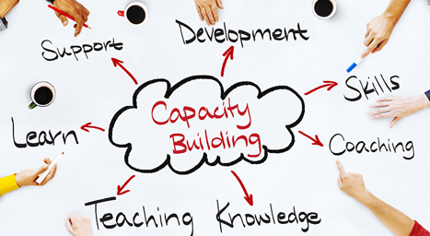
General capacity building activities
Gather state-of-the art knowledge on e.g. legal barriers and mainstreaming
Have an ongoing dialogue with relevant government agencies
Connect actors and build a learning community in the region
Disseminate knowledge within and beyond the project

Slide 7
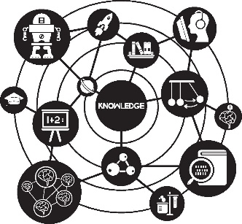
7 Cross cutting capacity building activities
Common challenges:
Sea and Fjords
Lakes and Rivers
Groundwater
Rainwater
Common tasks
  Governance
  Tools
  Innovation

Slide 8
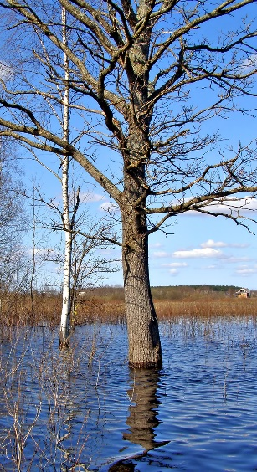
Specific activities - 1
Common challenges:
  Sea and Fjords
  Lakes and Rivers
  Groundwater
  Rainwater
Identify knowledge gaps
Hold workshops and courses
Build lasting networks
Include latest research
Identify synergies and trade-offs
Sustainability ↔ Coastal protection
Farming ↔ CCA ↔ Wetland restoration
CCA ↔ Water ecology
Private measures ↔ Public measures

Slide 9
Specific activities - 2
Common tasks
  Governance
  Tools
  Innovation
Promote integrated planning
Develop regional strategy
Promote stakeholder dialogues
Develop common tools and models
Develop new business models

Slide 10



Advisory committee
A Capacity building task force
3 research institutions
  Bring latest knowledge from research into the projects
  Utilise knowledge from practice in new research
  Promote learning across projects

Slide 11
Advisory committee tasks
Challenge projects
Identify synergies
Identify complementary projects
Workshops
Engage stakeholders
Advice

Slide 12

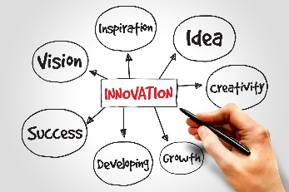
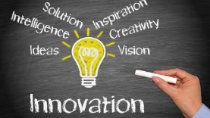
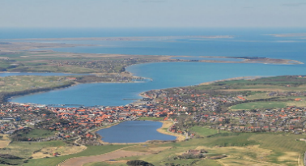

Questions
What could make you visit the Climatorium?
How do we become even better at supporting development of climate products and services?

