Slide 1


Cross boundary innovation and business development in Central Denmark Region
ECCA Session Wedensday 7th of June 2017
Christoffer Buch-Larsen
Business developer
chrbuc@rm.dk
, r
Notes:
Thank you. My presentation is called cross boundary innovation and business developement in Central Denmark Region and that sounds a bit boring, så what I will be doing is structuring the presentation around three questions:
Which climate challenges do we have in Denmark on a national level in general?
What challenges do SME´s have in our region in relation to realising the big business oppurtunities in climate adaptation?
What does C2C CC give us in relation to overcoming these challenges?

Slide 2
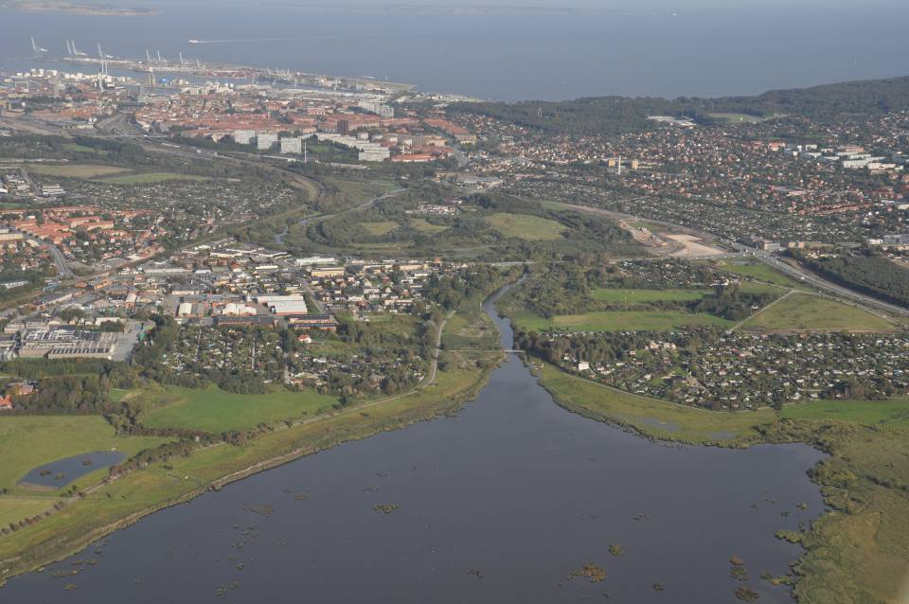
Challenges with water in Denmark i 2100
10-40% More rain
Common know challenges
½-1m rise of sea level
5-15 %
Increased water flow
0-2 m rise of groundwater level
Notes:
On a national level climate challenges are:
More rain: 10-40% in 2100
Rising sealevels: ½-1 m rise in sealevel in 2100
The groundwater will rise up to 2 meters
5-15% increase in waterflow due to more rain
Climate challenges = business opportunities. Solutions to these challenges in an intelligent matter will create new jobs and increase exports in this market and give us an opportunity to help other regions and countries who face similar challenges.
Solutions to these problems are complex and demand inputs and knowledge from different sectors and knowledge diciplins
Adressing the water challenges incoporation holistic solutions requires interdiscilpinary and cross-organisational cooperation

Slide 3
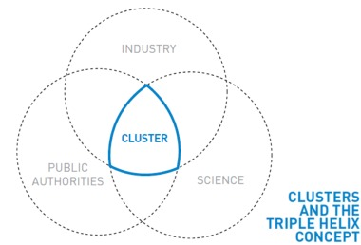
Competences are spread across different sectors
Best Solution
Notes:
Knowledge and competences are spread across many different actors and sectors who do not always coordinate and use each other (ex. business and academia) Academia has the newest knowledge. Business is focused on reducing pains for profit and the public sector makes laws and regulats and is also a huge percurer in this sector.
This is a huge challenge to make these sectors cooperate better and see each other as each others strenghts rather than opposites!!!
Water does not no boundaries and neither do the good solutions.
------------------------------------------------------------------------------------------------------------------------------

Slide 4
Regional SME challenges
Lack of finance in genreal and knowledge about the possibilities of EU-funding
The lack of knowledge in CA opportunities and including eco-system services in business development
Difficulty of cooperation between SMEs and larger companies in this area
The exports of water solutions is decreasing
Notes:
START: If we take a closer look at the regional challenges throw the eyes of SME´s in the region there are a number of challenges
Lack of finance in genreal and knowledge about the possibilities of EU-funding
The lack of knowledge in CA opportunities and including eco-system services in business development
Lack of coordination between SMEs and larger companies
The export on water solutions is falling
SLUT: Why are all the challenges a problem? They are not – they are a huge opportunity!!!!

Slide 5

Water is a huge market:
The global market is 500 billions USD every year.
UN estimates the accumulated extra investments due to climate change in the world is between 100 billion USD every year.
Brobuerne, Struer
Notes:
The global market for waterrelated products and services is 500 billion USD each year today and the market is expected to grow in the future with 100 billions USD a year
The potential market is 3 times as big as the market for windenergy
The Danish Government has an ambition to double the danish export on waterteknology and knowledge in 10 years. This is called the Watervision 2025
According to the Ministry of environment this could create 4000 new jobs in Denmark.
The ”private” watersector in Denmark is constituted by about 230 companies and 60 (1/4) of these are laying in Central Denmark Region (our region) so the realisation of Watervision 2025 could mean more than 1000 new jobs in this sector in our region.
I dag udgør eksporten på vandområdet knap fire pct. af den samlede danske eksport så we want this nummer to be 8% in 2025
So Central Region Denmark has a huge interest in suppuring the development of this sector

Slide 6

What does Coast to Coast Climate Challenge give us?
Notes:
What will C2C CC give us in relation to overcome the identified challenges among SME´s in the region and the national challenges?
How does the project try to adress some of these challenges into opportunities for innovation and business development?

Slide 7
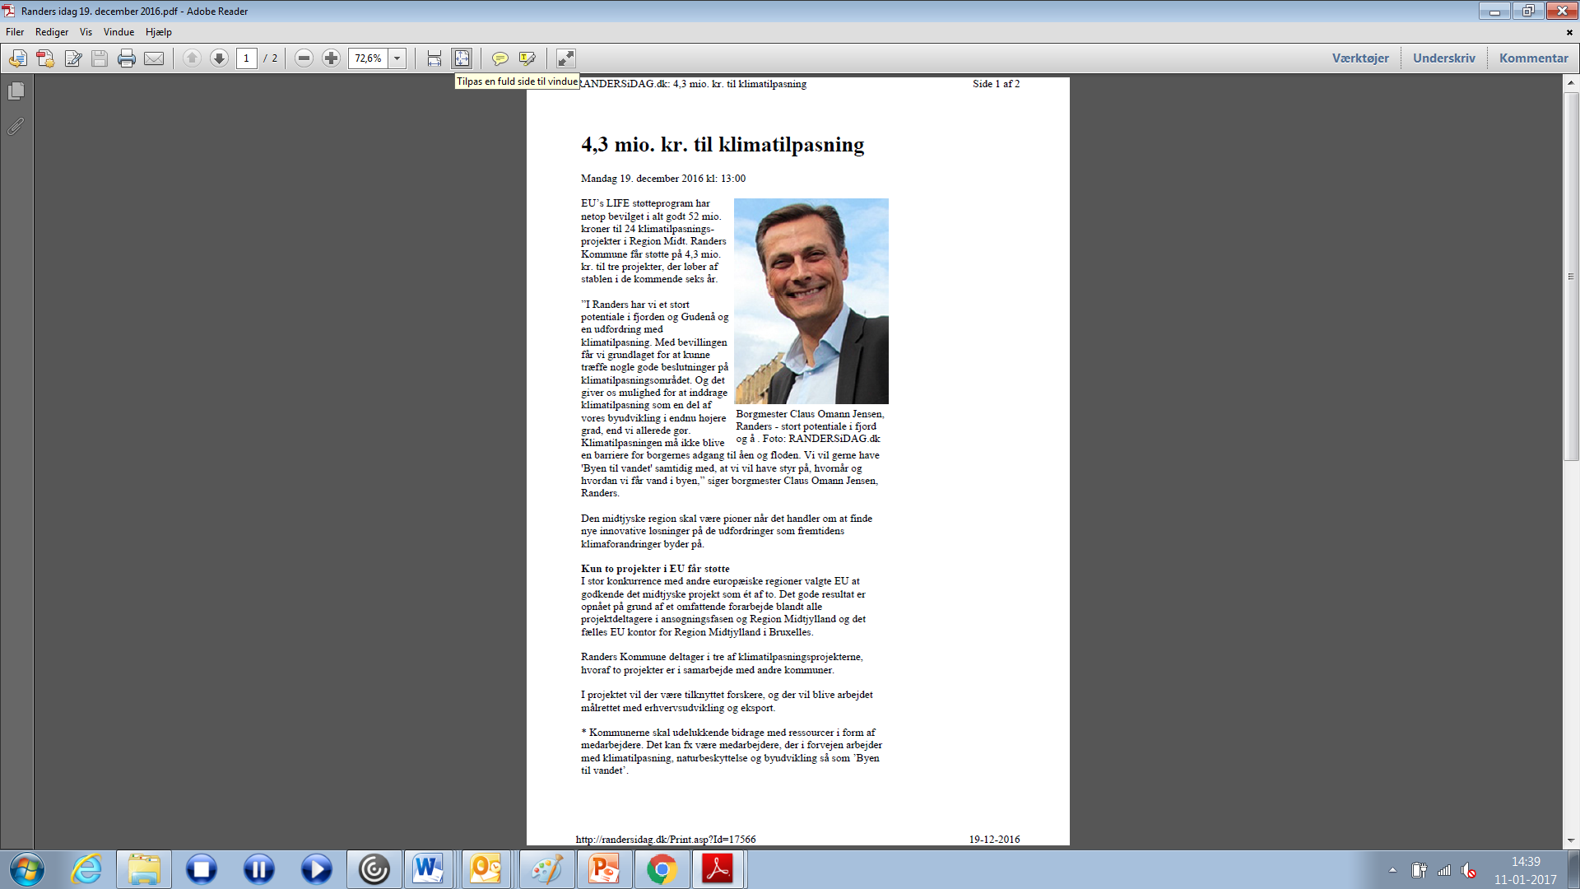
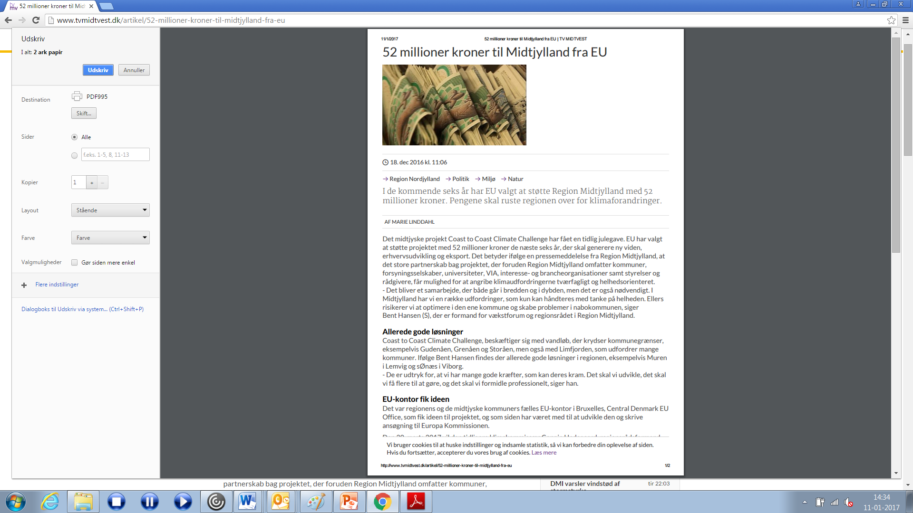
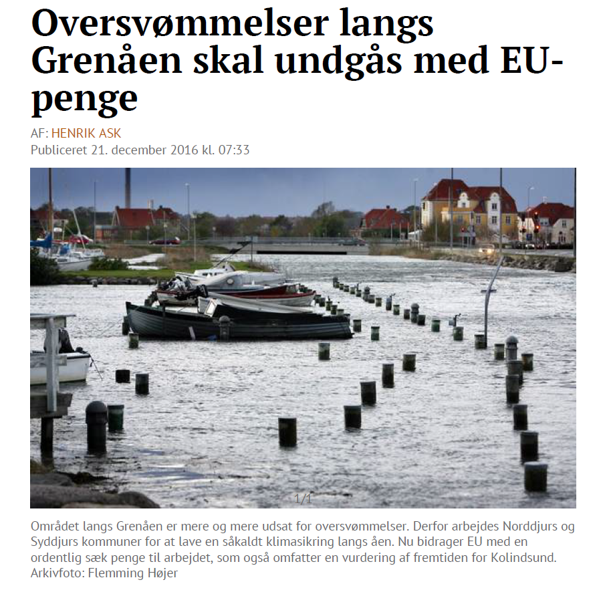
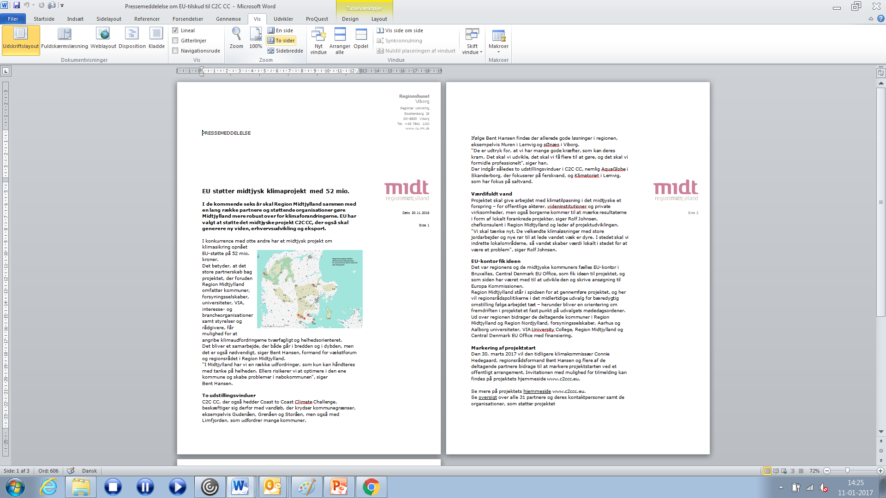
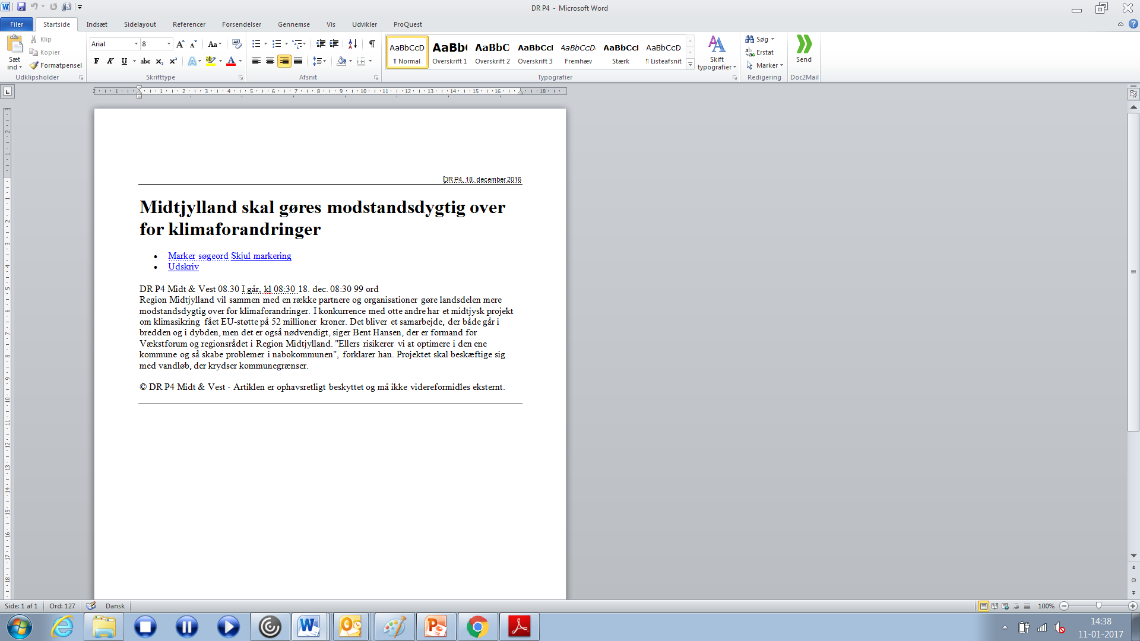
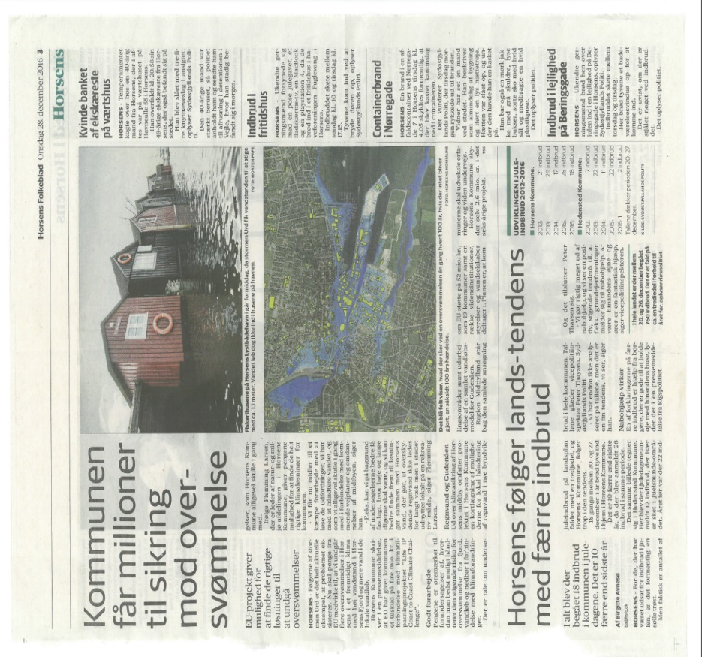
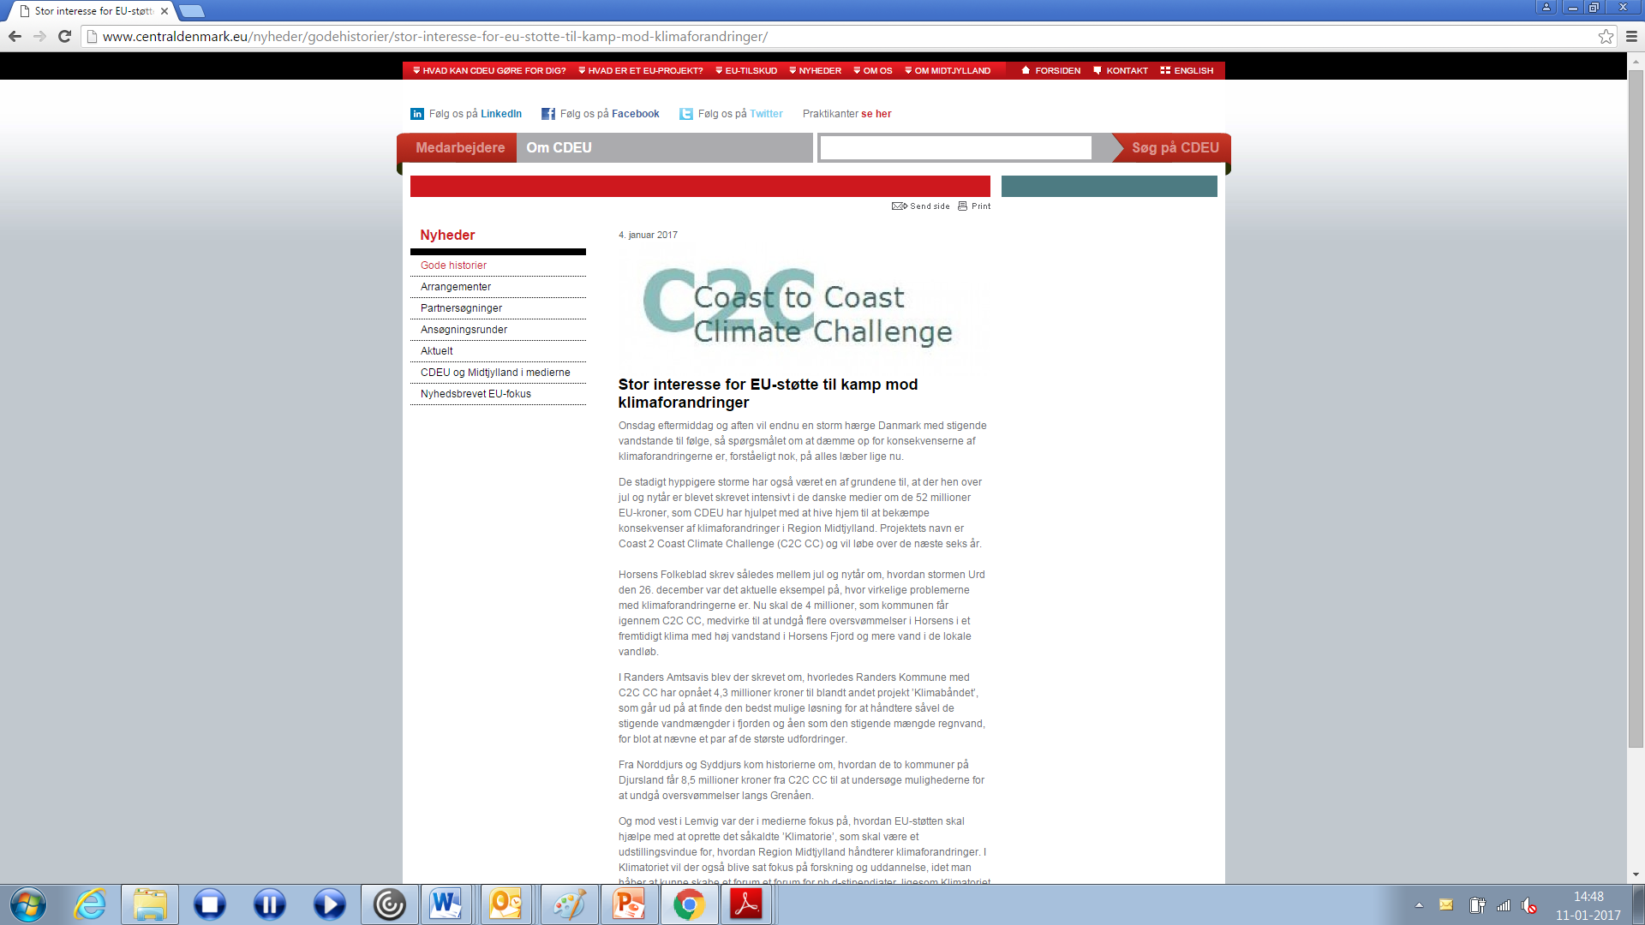
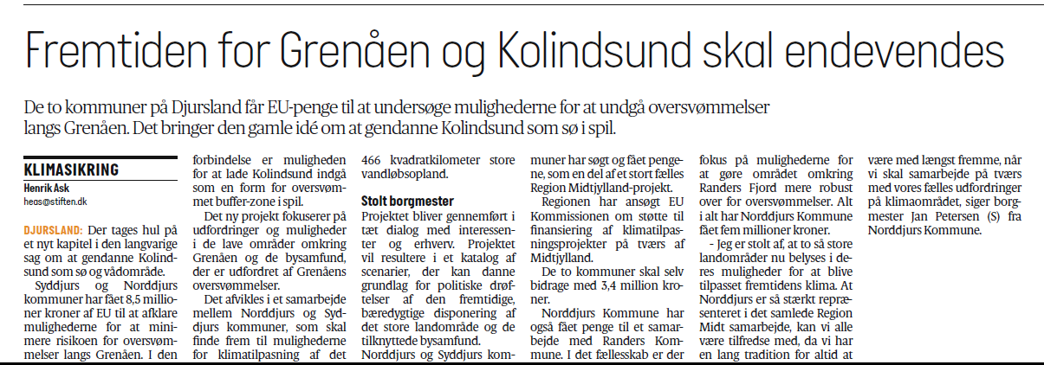
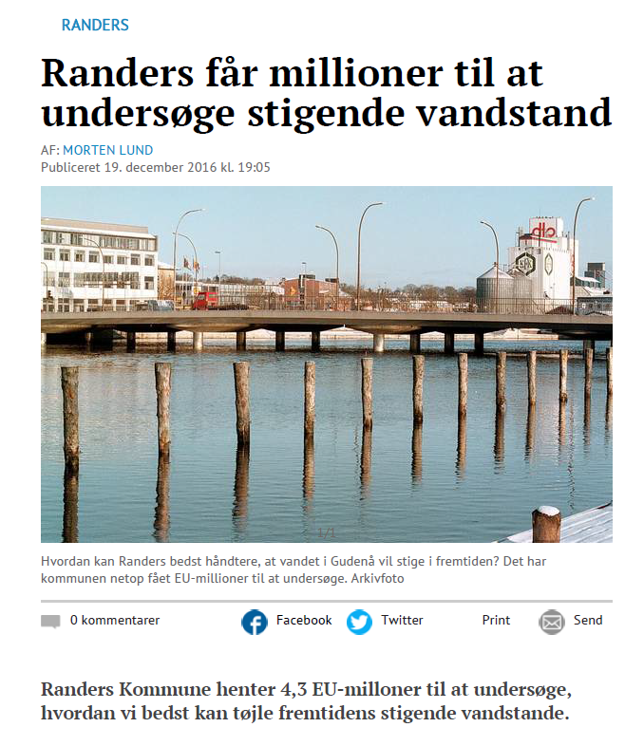
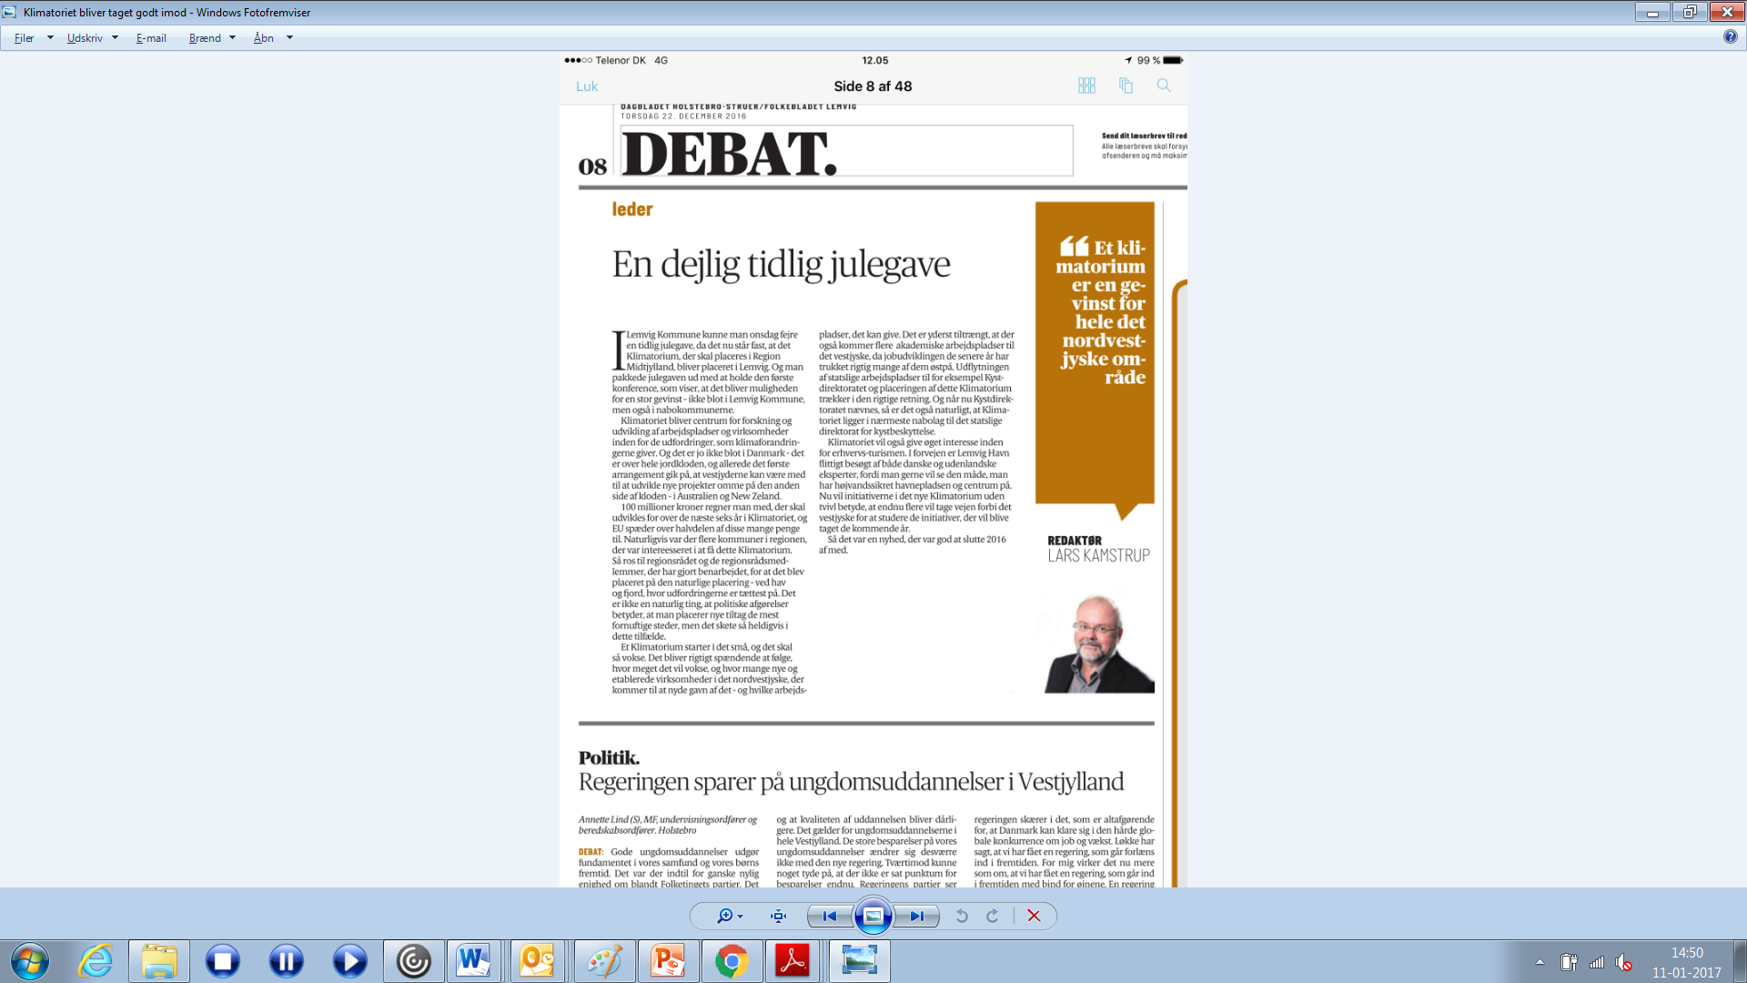
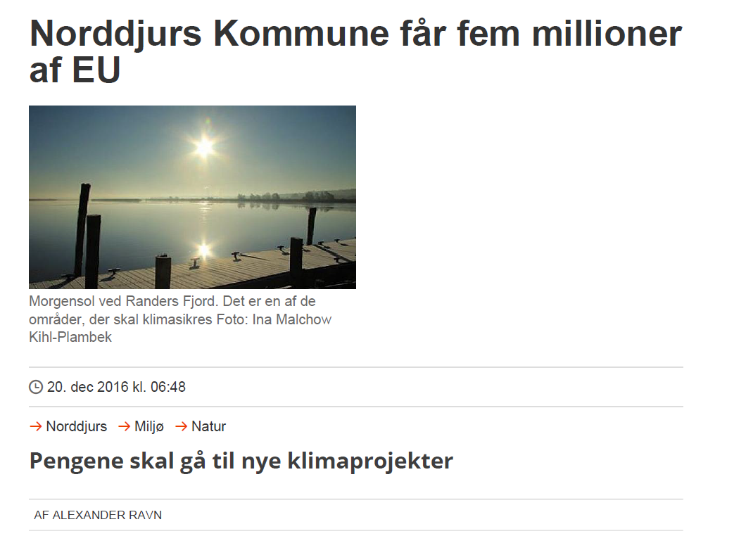
Branding and publicity...
Vi lykkedes med at styre presseomtalen!
Notes:
Well first of all Coast to Coast Climate challenge has allready given us a lot publicity at the national level as a ”climate region”. This is important in the overall branding of our region as beeing percieved as frontrunners in this area. We plan to get a lot more publicity in the upcoming years. Both nationally but more important: internationally.

Slide 8

EU-funding for SMEs
Develop information material on EU funding
Individual counselling of SME´s on e.g. Horizone 2020
Close coordination with Central Denmarks EU Office
Notes:
1) Coast 2 coast gives us a possibility to develop information material on EU support and funding possibilities to be sent to small and mediumsized companies, relevant networks and minicipal business promoters in our region

Slide 9
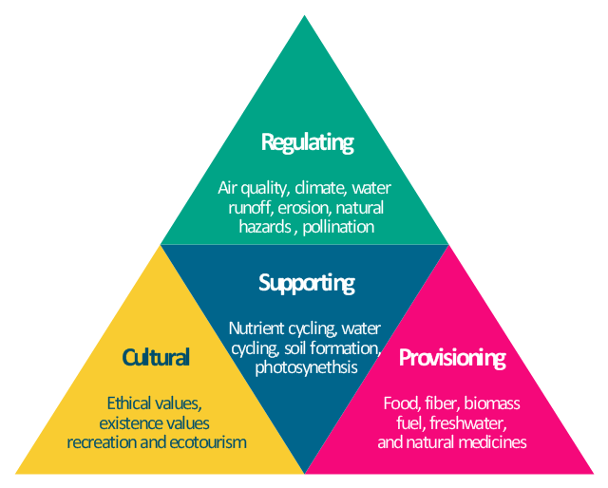
Training start-ups within ecosystem services
Dialogue with companies on ecosystem services business development
Coaching of start-up companies

Slide 10
Network and cluster development
Large companies
SME´s
17 water ultilities
17 municipalities
Aarhus University
Aalborg University
2 regions
VIA Universtity College
Notes:
C2C CC gives us a strong network across many climate adaptation stakeholders . This is the fundament for cluster development and holistic climate adaptations solutions. Cross sectoral colaboration between all there sectors and cross-boundary collaboration witin each sector is the key to both the best solutions but also the solution to a state of the art cluster around innvative climate services and products in Central Denmark region.
The full potential can only be reached if this stakholders works close together. This is what we are good at but want to be even better at in Central Denmark Region.
Central Denmark Region will actively support the emering cluster and try to better collaboration between this stakeholders in order to support consisions crossboundary innovation and buisness development for jobs and better exports.
(Vand- og klimatilpasningsvirksomheder står overfor mange af de samme udfordringer som vindindustrien oplevede for få år siden inden Region Midtjylland var med til at løfte området via eksempelvis understøttelse af netværk for underleverandører (jf. Mandag Morgens analyse). Dvs. der er en plads og opgave for regionen i forhold til at skabe bedre ramme betingelser som vi gjorde for vind. Læg her til at Region Midtjylland har mere end 25% af vandvirksomhederne i DK og at markedet for klimatilpasning vurderes at være tre gange så stort som markedet for vind - det giver en idé om at der kan være et kæmpe uudnyttet potentiale her i forhold til at skabe vækst og arbejdspladser i RM. 1% mere eksport på området i DK svarer til 4000 nye arbejdspladser jf. Vandvision 2025. Og det svarer alt andet lige til 1000 nye arbejdspladser i Region Midtjylland.)

Slide 11
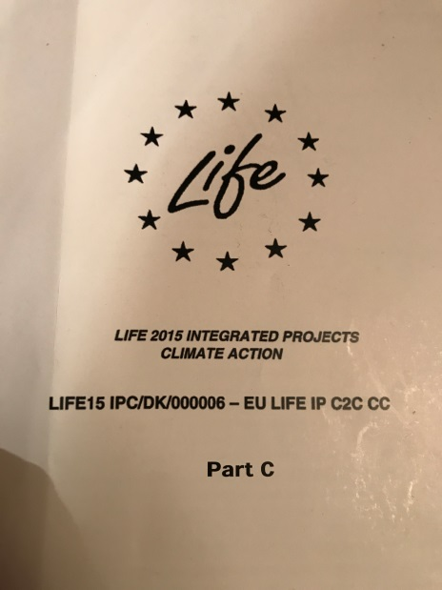
24 triple helix cases!
RAINWATER
GROUNDWATER
RIVERS
SEA & FJORDS
GOVERNANCE
Brobuerne, Struer
TOOLS
INNOVATION
Notes:
Coast to coast gives us 24 triple helix cases on solutions to clamate adaptation challenges. This gives us excellent fundament for at danish storytelling around climate adaptation solutions across different sectors, boundaries and disciplins.
Though 24 projects 31 partneres will collaborat on these solutions with will make our cases really strong and appealing to the worlds challenges on climate adaptation.
Jobs and bettering danish exports – Water Vision 2025

Slide 12
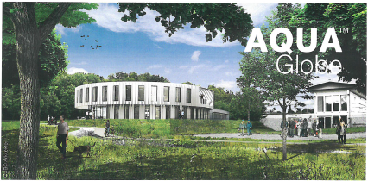
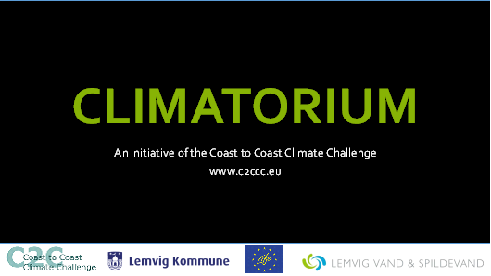
Two state of the art show rooms!
Aqua Globe:
Showcase freshwater solutions
Climatorium:
Showroom for solutions on saltwater
Brobuerne, Struer
Notes:
Two state of the art showrooms. One in Skanderborg in the eastern part of our region and one in Lemvig placed in the western part of our region.
These to exebitionrooms will showcase the danish solutions to climate adaptions challenges both the ones developed in Coast to Coast Climate Challenge but also complementary project which will be a spinoff of Coast to Coast Climate Challenge the next six years.
In Central Denmark Region the are many companies, public institutions, utilites and interest organizaions who work with water on different levels and our solutions can compete internationally. Good solutions are found across the whole region and more are coming every year.
C2C CC gives us two new showrooms so we can show the world our fine solutions to water management in a professionel manner which will help climate tourisme, business development and exports in the region.
AquaGlobe which is placed in Skanderborg in the midle of our region will focus on exebitioning freshwater solutions (SUDS) and best case exaples both of the experiences done across the 24 differenct cases in C2C CC but also other best cases which will emerge in Denmark the next six years.
Central Denmark Region will try to combine these to showrooms with national platforms in order to create more synergies ex. cloaboration with Invest in Denmark (attract foreign investments to Denmark) and State of Green (which is a national showroom for alle green best pratices in Denmark)

